Slide 1

ICAI General Assembly
16 JULY, 2022
12:00 – 2:00 PM Togo time

Slide 2
Welcome and Check-in (15 mins)
Name / Where are you from ?
What has been happening in your ICA in 2022?
How have you been influenced by relating to other ICAs this past year (since July 2021)

Slide 3
Present: 65 registered ; 52 attended
(Simultaneous translation in French and Spanish (Mireille Menard, Catalina and Cynthia)
Africa
Benin: Kassimou Issotina
Ghana: Ken Kinney
Kenya: Henry Mpapale
Nigeria: Hannah Anighorn
Togo: Yawo Gator Adufu
Uganda: Charles Wabwire
Zimbabwe: Gerald Goman
Europe/Middle East
Great Britain: Derek McAuley
Iran: Shahrazad Saderi
Spain: Cecelia, Catalina Quiroz-Nino, Juan Jose Roca Escalante
Regrets: The Netherlands
The Americas
Canada: Virginia Kanyogonya, Mireille Menard (French Translator), Jan Sanders, Jeanette Stanfield
Chili: Isabel de la Maza, Gerd Luders
Guatemala: Lisseth Lorenzo
Peru: Cynthia (Spanish Translator)
United States: Alan Gammel, Ruth Gilbert, Deborah Graham, Beret Griffith, Tim Leisman, Paul Noah, Lesley Showers, Karen Snyder. Nelson Stover, Jim Troxel, Sunny Walker, Jim Wiegel, Meg Zeigelman
Asia
Australia: Kevin Balm, Robyn Hutchinson
Bangladesh: Aziz Rahman
China: Mark Pixley, Michelle Zhang
India: Archana Deshmukh, Bhimrao Tupe
Japan: Don Hinkelman
Nepal: Ishu Subba, Tatwa Timsina
Philippines: Junifen Gauuan
Sri Lanka: Puthrika Moonesinghe
Taiwan: Evelyn Kurihara Philbrook, Larry Philbrook, Eric Tseng

Slide 4
Agenda:
What | Facilitated by | Time
Welcome and Check In | Henry | 15 mins
Team Report : Each team share the report ( 2 mins) Participants feedback in Chat Box | Derek | 20 mins
Recommendations: o Membership Care Team (15) - Jeanette o Organizational Sustainability Team (15) - o Pursuing ICAI Signature Programs (10) | Ishu | 45 mins
Reflection on Team Learnings: | Derek | 10 mins
Treasurers Report | Lisseth | 15 mins
Announcements, Next Steps and Closing | Kevin | 10 mins
4

Slide 5
Team Report : ( 20 mins)
Each Team share
“Accomplishments – last six months” & “ Goals – next six months”
Participants listening to report, share your Appreciation, Recommendation or Suggestion in Chat box.
GEOGRAPHIC FOCUS | MISSIONAL IMPACT | INTERNAL STRENGTHENING
· REVITALIZE AFRICA ICAs · ASIA PACIFIC · IBERO AMERICA · GLOBAL CONFERENCES | · COMMUNICATIONS · ToP APPROACHES · UN RELATIONS | · CORE TEAM · FUNDRAISING · MEMBERSHIP CARE · ORGANIZATIONAL SUSTAINABILITY
5

Slide 6
REVITALIZE AFRICA ICAs TEAM
Past Activities | Scope/Focus of ICAI Africa Team | Future anticipation
Developed Africa Strategic Plan Undergone Courage to Lead (CTL) training facilitated by ICA Canada for 12 ICAs in Africa. Weekly and monthly Africa meetings Engaged monthly to plan for the Africa ICA conference scheduled for 23rd to 28th October 2022. Launched Southern ICAs Climate Change work in Kenya, Zimbabwe, Uganda, Ghana, Benin, Togo, Tanzania, Cote d’Ivoire, Nigeria and Zambia. ICA Kenya, ICA Tanzania and ICA Zambia have been reinstated in the last 12 months. Some Africa ICAs leaders have received training in ToP from ICA- Taiwan and ICA-Australia South Africa Development Institute confirmed as ICAI Associate member. | A strong and visible continental Africa ICAs We intent to empower an environmental network of ICA affiliated organizations in Africa. Apply what we have learn through CTL training and for our partners, women and youths programs. Fundraise for Africa Conference. Continue dialogue with likeminded ICA organisations and community development partners. | Develop Tools for sustainable community development in Africa: Women and Youth as critical facilitators Elements and strategies for building resilience to climate change for communities in Africa. Functional Infrastructure and governance for sustainable community development in Africa. Africa ToP system development and for business in Africa within the framework of Africa Continental Free Trade Area (AfCFTA) Partnerships, communication and funding for sustainable community development in Africa. The four ICA signature programs (Courage to Lead, Climate Change Action, Learning Basket and ToP Training). Africa ICAs Conference in Kenya, 2022 ICAI Global Conference in Ghana, 2024

Slide 7
MEMBERSHIP AND CARE TEAM
Accomplishments – last six months | Goals – next six months
We focused on re-thinking membership categories and roles. We shared our thinking in April with the board. We held a global dialogue on membership categories and roles in June. Based on the reflections of the board and global dialogue, the following recommendations will be shared with the GA later in this meeting. | Based on the recommendations of the GA we will create assessment processes in relation to the new categories and roles. We will then collaborate with members to assess their own organizations, the roles they are playing now and roles they wish to play in the future. We will share what we are learning with the board and GA.

Slide 8
COMMUNICATIONS TEAM
Members: Catalina Quiroz, Eugene Konan, Henry Mpapale, George Zeidan, Isabel de la Maza, Karen Snyder, Rena Koc, Shaharzad Saderi
Accomplishments July 2021-July 2022 | Future Goals July 2022-Dec 2022
Regular monthly meetings held and discussed issues | Continue with meeting consistency and invite others to join and take
Hired George Zeidan for our website New website launched in July | Increase communications with all the 35 countries to create stronger connections and encourage sharing videos and stories. Update all the older information on the new website
Hired Rena for Social Media Specialist Global Buzz March - June issues Increased ICAI LINKEDIN visibility from 100-300+ Global Buzz contributions are increasing through the letter send to all ICA Instagram launched with 170 followers (https://www.instagram.com/ica_international/) | Improve our communication among all ICAI members, especially on new ways of communicating Increase LinkedIn and Instagram to 1000 members Increase 5-7 posts per month to LinkedIn and instagram, host on line activities to engage members Making sure we have at least 7-8 articles in each one of our Global Buzz issues

Slide 9
GLOBAL FUNDRAISING TEAM
Accomplishments – last six months | Goals – next six months
The establishment of a Global Fundraising Team comprising 10-12 people from Africa, Asia and North America Operating in three streams targeting different potential fundraising segments – The Global ICA community, Grant making bodies, in-country fundraising mechanism (the Nepal Fundraising model) Working with ICA Nepal to begin to put in place the fundraising mechanism in Bangladesh, India and (scheduled for Oct.), Africa Identified mechanisms and processes to support transparency and accountability for disbursement and receipt of funds (EG: MoU Aggregation of data and information towards building a picture of global story(s) for raising funds from target segments | Stream 1: Global ICA community - focus on a process to identify micro level ICA needs and interests, reports and stories that could be used for fund raising. Ideas that could help raise hundred dollar donations from ICA colleagues around the world. Six month victory: A catalogue ICA needs & interests, reports and stories that are fundraising ready. Stream 2: Grant making bodies – work in collaboration with the Global ToP and Org Sustainability Teams to develop proposals to take to family foundations in the US to strengthen ICA capability and capacity to generate revenue from ToP training. Six month victory: two proposals and a plan for who to target and how to manage submission of proposals. Stream 3: In-country fundraising mechanism – continue the roll out of the Nepal fundraising model to ICA Bangladesh, ICA India and African ICAI members. Invite south America ICAs to join the initiative. Six month victory: funds beginning to flow to ICAs.

Slide 10
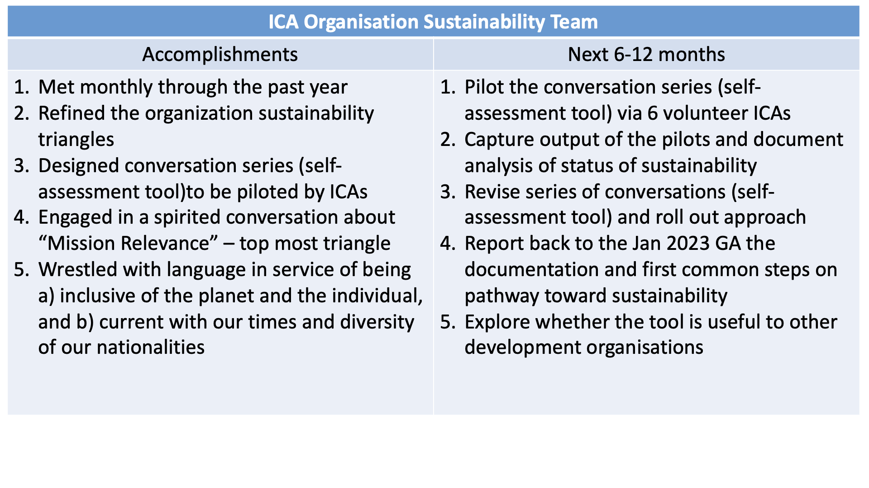

Slide 11
UN RELATIONS TEAM
Past Activities | Scope/Focus of ICAI UN Team | Intended activities
Submitted quadrennial report to ECOSOC Have consultative status with multiple UN entities Parallel events with UN Women each year on different topics. This year about Peace building and de-mining Since 2017, submitted statements on Status of Women Facilitation & training work with UN Commissions in Asia Pacific, Africa, UNOV-UNODC Ukrainian women’s delegation to UN each year UNICEF support of Ukrainian kindergarten in Romania Educational program on drug prevention in Ukraine - UNODC Participated in UN meetings in Geneva & Vienna | Promoting (capability in) participatory approaches as a viable way for grass roots involvement in social change Non-formal education approaches - SDG 4 Engage in global dialogues, eg: peacebuilding, cross-cultural, global citizenry Equity and empowerment of women helps everyone – SDG 5 Focus ICAI’s UN Relations on ToP approach (participatory methods) in the arenas of Women and Youth development | Explore other accreditations in relation to Climate - UNFCC, UNEP Establish connections with other NGOs (5k associated with UN) through working groups Contribute to the next Statement on Status of Women Commission Meet the 1st Thursday of the month. Next is Aug 4th, new team members welcome!

Slide 12
ASIA PACIFIC TEAM
Accomplishments
Monthly gatherings
  ICAI vision and structure review
  Regional Conference
  Nepal Fundraising
Cross ICA sharing and collaboration multiple projects among members
  Fund raising interchange Nepal Bangladesh India
  Facilitation trainings hosted by ICA Taiwan with Nepal India and other members participating
Spear-heading ICAI restructure & global teams
Regular participation from new colleagues and many not from member nations across Asia and other regions – For professional development and as an opportunity to experience and share our ICA culture
Challenges and next steps:
An Asia- Pacific/global conference – focus? Purpose? Timing?
What is our focus now? What is the mission and task - the next leap?
Sustainability of some ICA’s
Implementation of global and regional team work
New projects
· Learning basket
· Social Artistry
· How do we learn from our experiences and do more disciplined review?
Six Month report
What makes a difference with APRM?
· Monthly gathering allows exchange of information from across our own region but also as others connect it can across the ICA network. Its like a family gathering every month.
· Regional gatherings before the pandemic were face to face I can still remember my many meetings are many meetings like in India and Nepal, etc etc.Views of what people are doing and here reports about them makes a lot of difference. Once you've seen the physical layout of the place.
· And another thing that draws me to this meeting is the consistent support for community development across all the people that are involved that's my interest and I see it happening over and over, I see a Nepal was in India and Nepal,
· This organization represents people that are doing a lot of different things for for people that really are needing needing the support they don't get any place else.
· I see this is unique in that way that they provide the kinds of support that is other organizations do not I think especially in Top and community development.

Slide 13
GLOBAL CONFERENCE TEAM
Accomplishments | Next 6-12 months
Conversation with Global Research Network , ICA APRM, ICA Africa. Current image: ● 2022: Regional virtual conferences (and other network groups like Top Network, Research) ● 2024: Global hybrid conference (Africa) | Because there are lots of global conversations already going on, we will temporarily stop this team activity until there is a clear requirement.

Slide 14
Recommendations:
Membership Care Team (15)
Organizational Sustainability Team (15)
Pursuing ICAI Signature Programs (10)
Climate action forums
Courage to Lead study
Learning Basket program
ToP training
14

Slide 15
Membership and Care Recommendations
Recommendations | Why
That the structural membership of ICAI continue to be made up of organizations. That individuals are welcome to continue to play important roles in activities and committees of ICAI as part of the larger ICA community. However we are not recommending that there be an individual membership category in ICAI. That structural memberships will include National Members and Associate Members of ICAI. That there will be two distinct Associate memberships: Development Non-Governmental Aligned Organizations and ToP Aligned Organizations. That all member organizations will have a vote at the General Assembly. That the board of ICA International will remain the same for the next 12 months of 2022-2023 during this testing time of new categories and roles. | ICAI was created as a network of organizations. These organizations invite individuals to be active members in their country projects and activities. Inclusiveness is a strong value of ICA. Shifting from categories of statutory and non-voting to National and Associate will align our membership structures with this value. All members will be able to vote in the General Assembly. We are defining members according to the roles they are playing in their own country. A National Member is an organization that is playing specific custodian and coordination roles in their country in addition to guiding effective projects and using ICA methods. We are suggesting two categories of Associate members because Associates are presently playing two different kinds of roles in their countries. Development Aligned organizations focus on supporting positive social change community-based efforts. ToP Aligned organizations focus on sharing ToP and other ICA methods. By linking roles and categories, we are bringing a new seriousness to the responsibility of being members and a sharper clarity to what is being asked of each membership organization. We are hoping that these changes will structurally strengthen the integrity of ICA International as a local/global community committed to sustainable social change. *Roles can be found here: https://docs.google.com/document/d/1yGWvaxUPhrY9iVi9uY5TnQAsweg1p1hD/edit

Slide 16
3. Pursuing ICAI Signature Programs (10)
Climate action forums
Courage to Lead study
Learning Basket program
ToP training
16

Slide 17
Reflection on Team Learnings : ( 15 mins)
What has happened to ICAI as a result of the work of these teams?
What teams have completed their task
What other teams should be started?
17

Slide 18
Review GA Vision below in light of ICAI Team Reports
GEOGRAPHIC FOCUS | MISSIONAL IMPACT | INTERNAL STRENGTHENING
· Empower diversity (culture, language, geography, perspectives) · Focus on key global theme(s) · Leverage ICA strengths and cooperation with global and regional conferences | · Initiate collaborations with diverse organizations through ICA methods (facilitation, intellectual, social and spirit) · Make a difference on the critical issues of our time (e. g., climate crisis, indigenous voice, racism) · Engage in action research on relevant social issues (youth, development) · Implement global strategies locally and regionally · Establish ICA unique role within global NGO community | · Revitalize ICA spirit globally · Strengthen participation, inclusivity and equity of ICAs · Increase organization sustainability of ICAs · Increase ICA interactions regionally and globally
18

